Slide 1
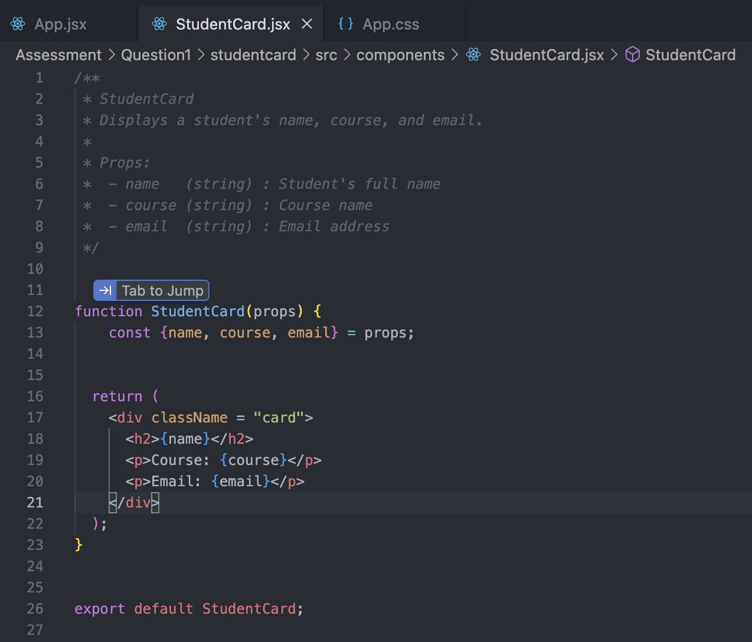
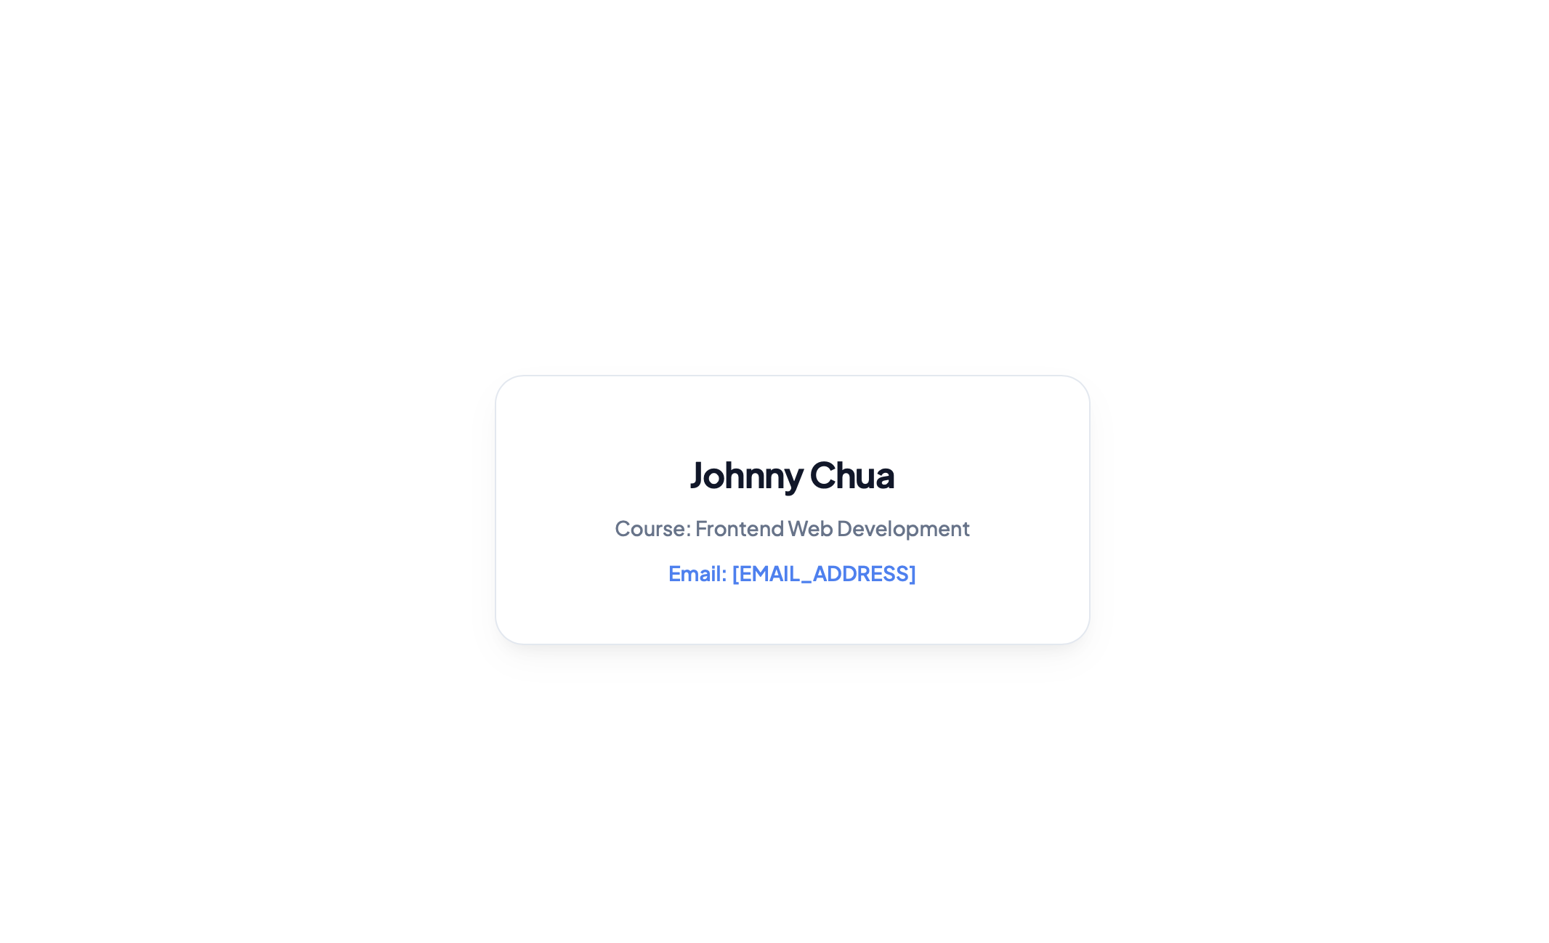
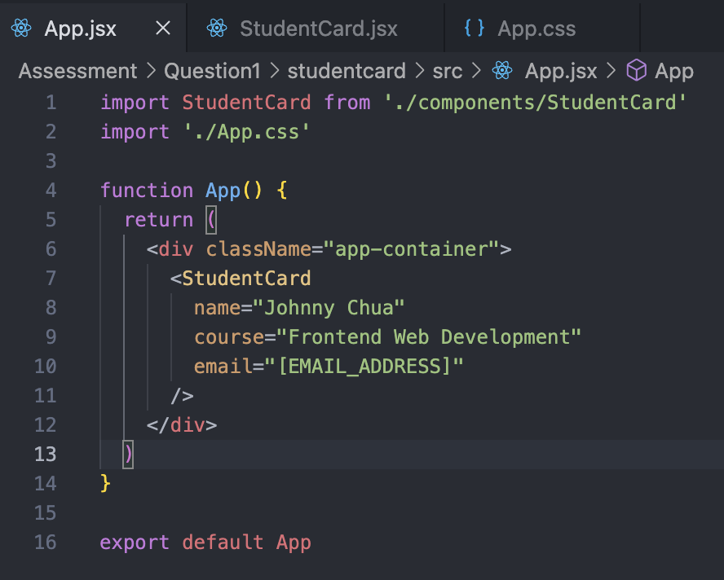
Question 1
Objective: Create a React component called StudentCard.
Requirements
Display:
Student Name
Course Name
Email Address
Use props to pass the data.
Display the information inside a styled card.

Slide 2
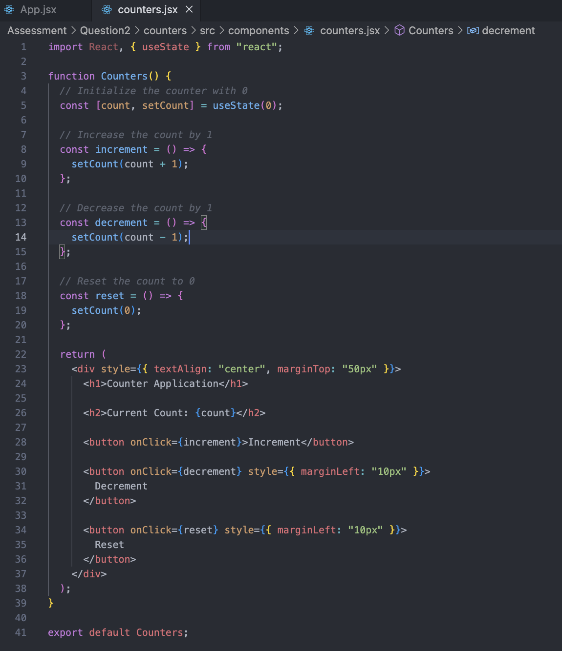
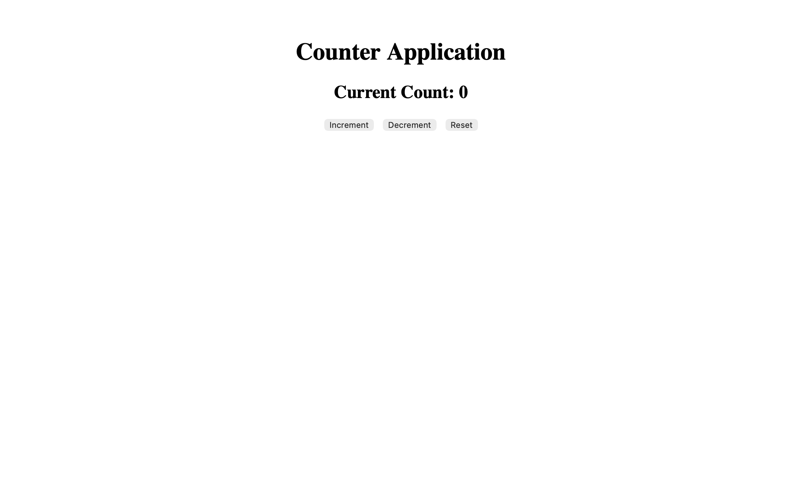
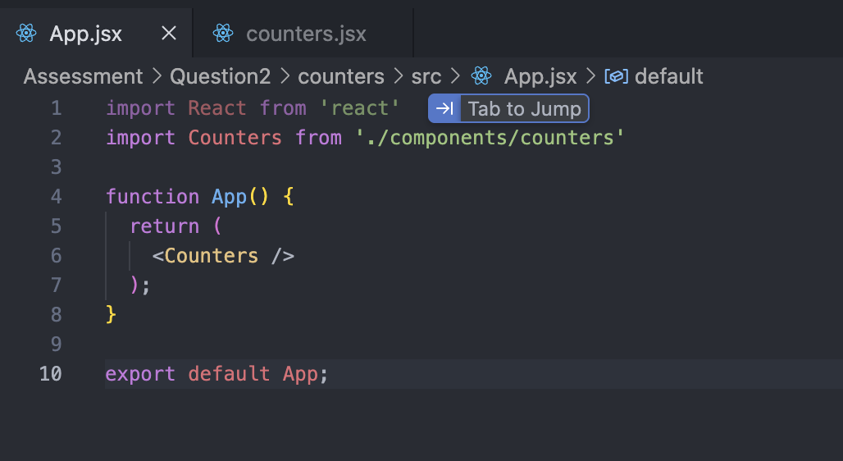
Question 2
Objective Create a counter application using React state.
Requirements Display the current count.
Add:
Increment Button
Decrement Button
Reset Button
Initial count should be 0.

Slide 3
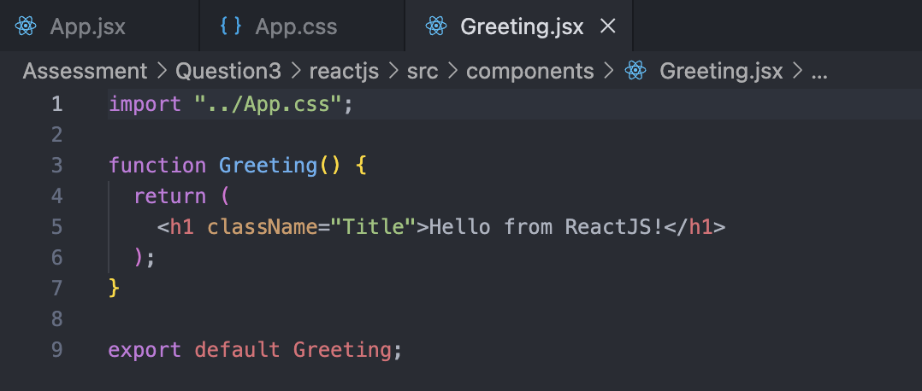
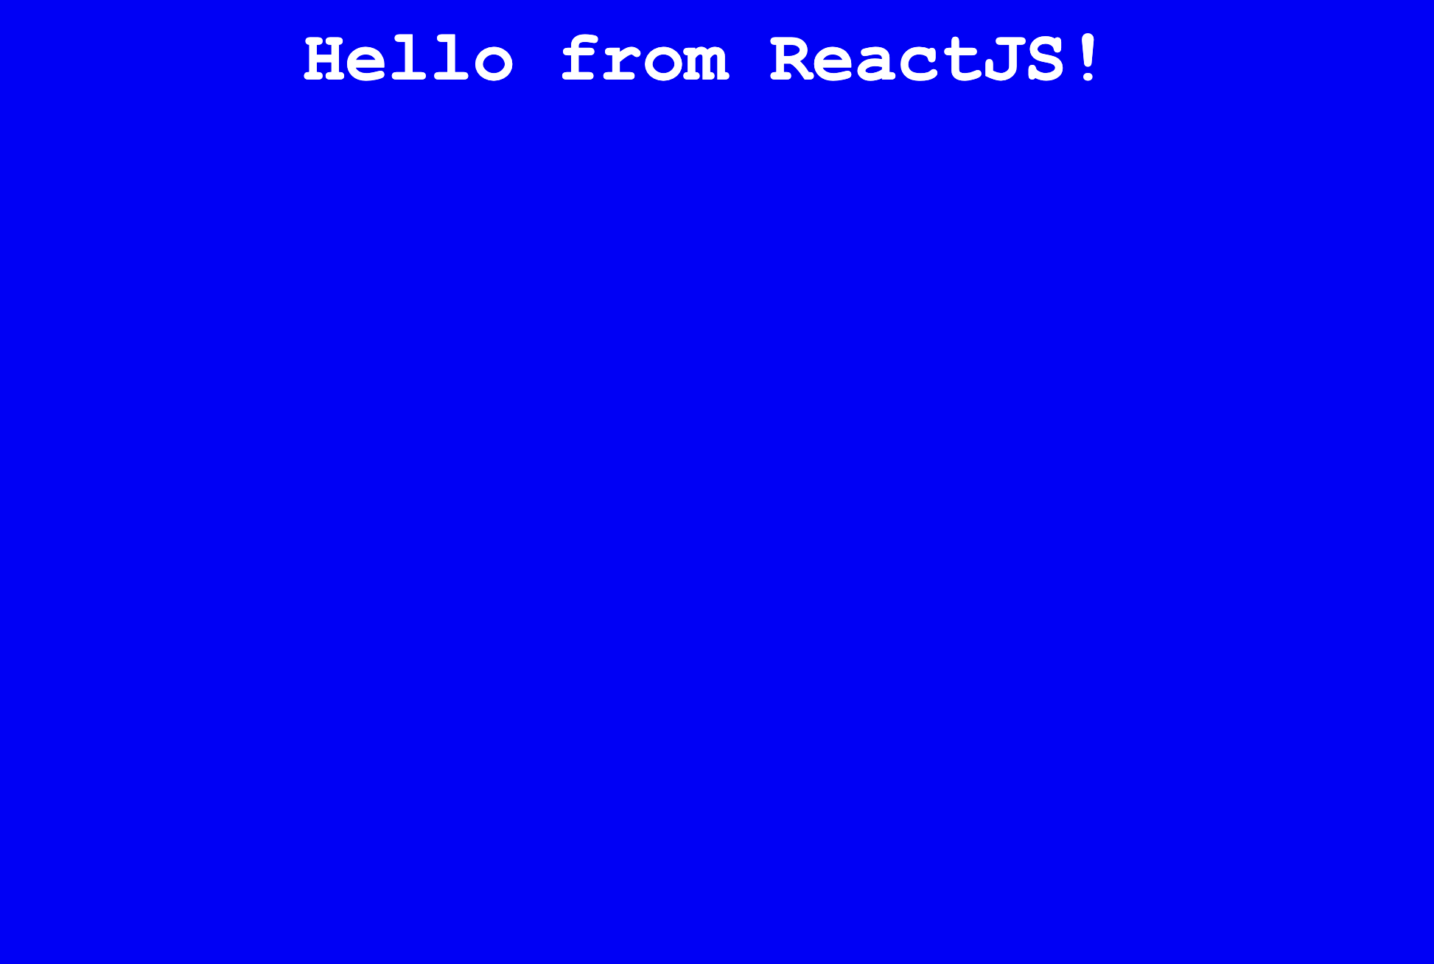
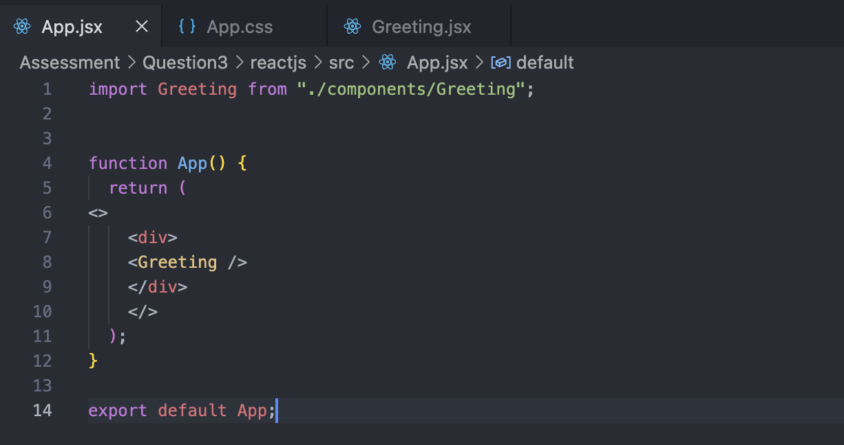
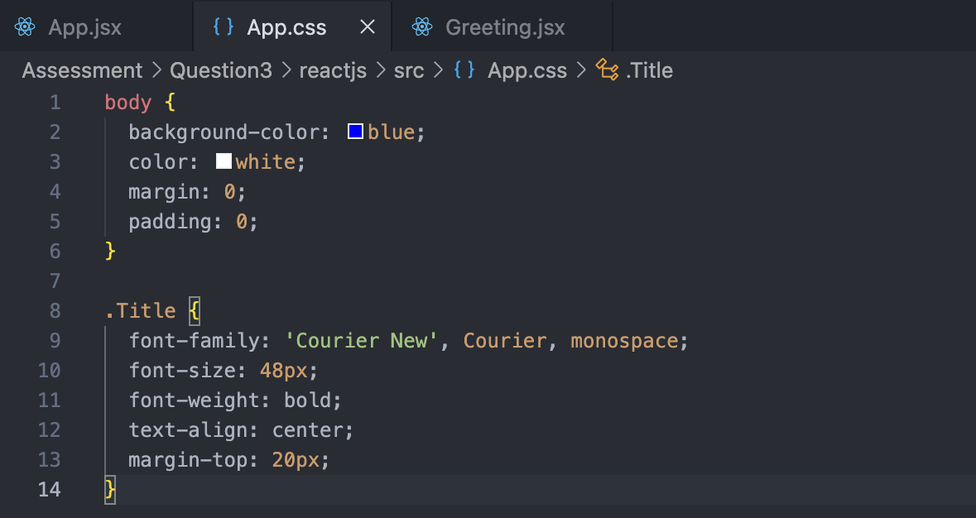
Question 3
Objective Implementing the ReactJS Component.
Requirements 1. Create a ReactJS Component:
a) In App.jsx, write a ReactJS component named Greeting that
displays "Hello from ReactJS!"
2. Verify the ReactJS Output:
a) Open App in a browser to check that the ReactJS component
displays correctly.

Slide 4
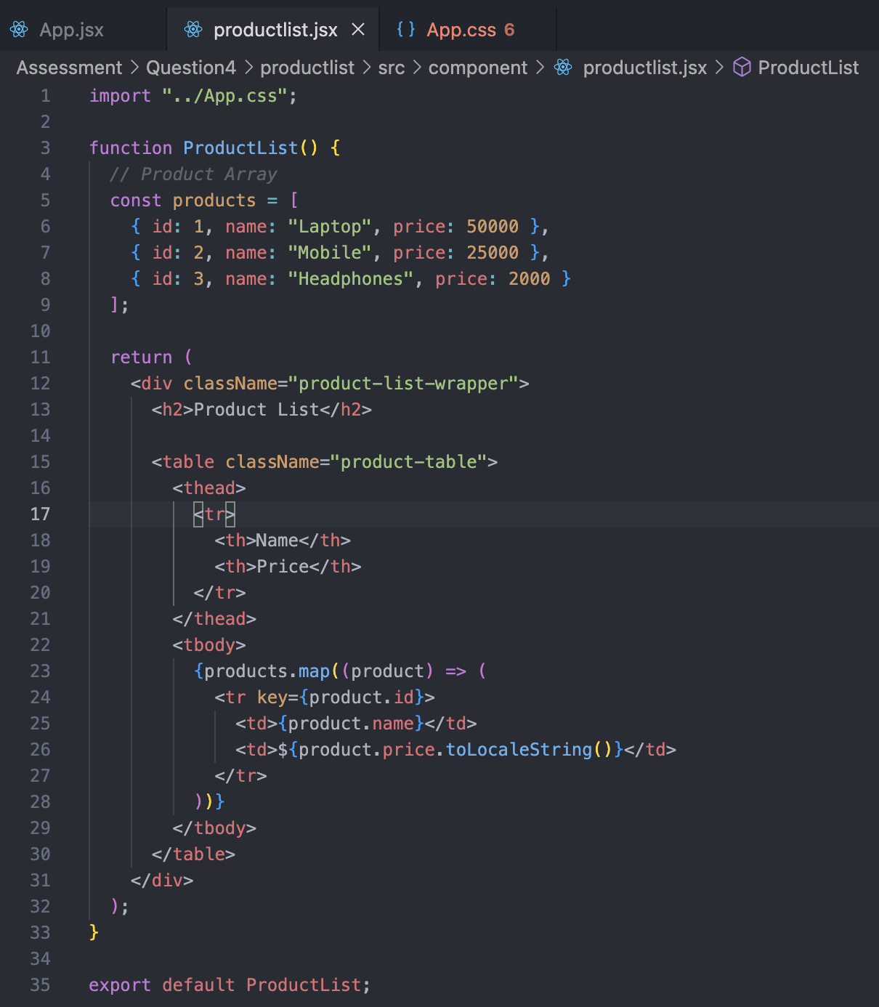
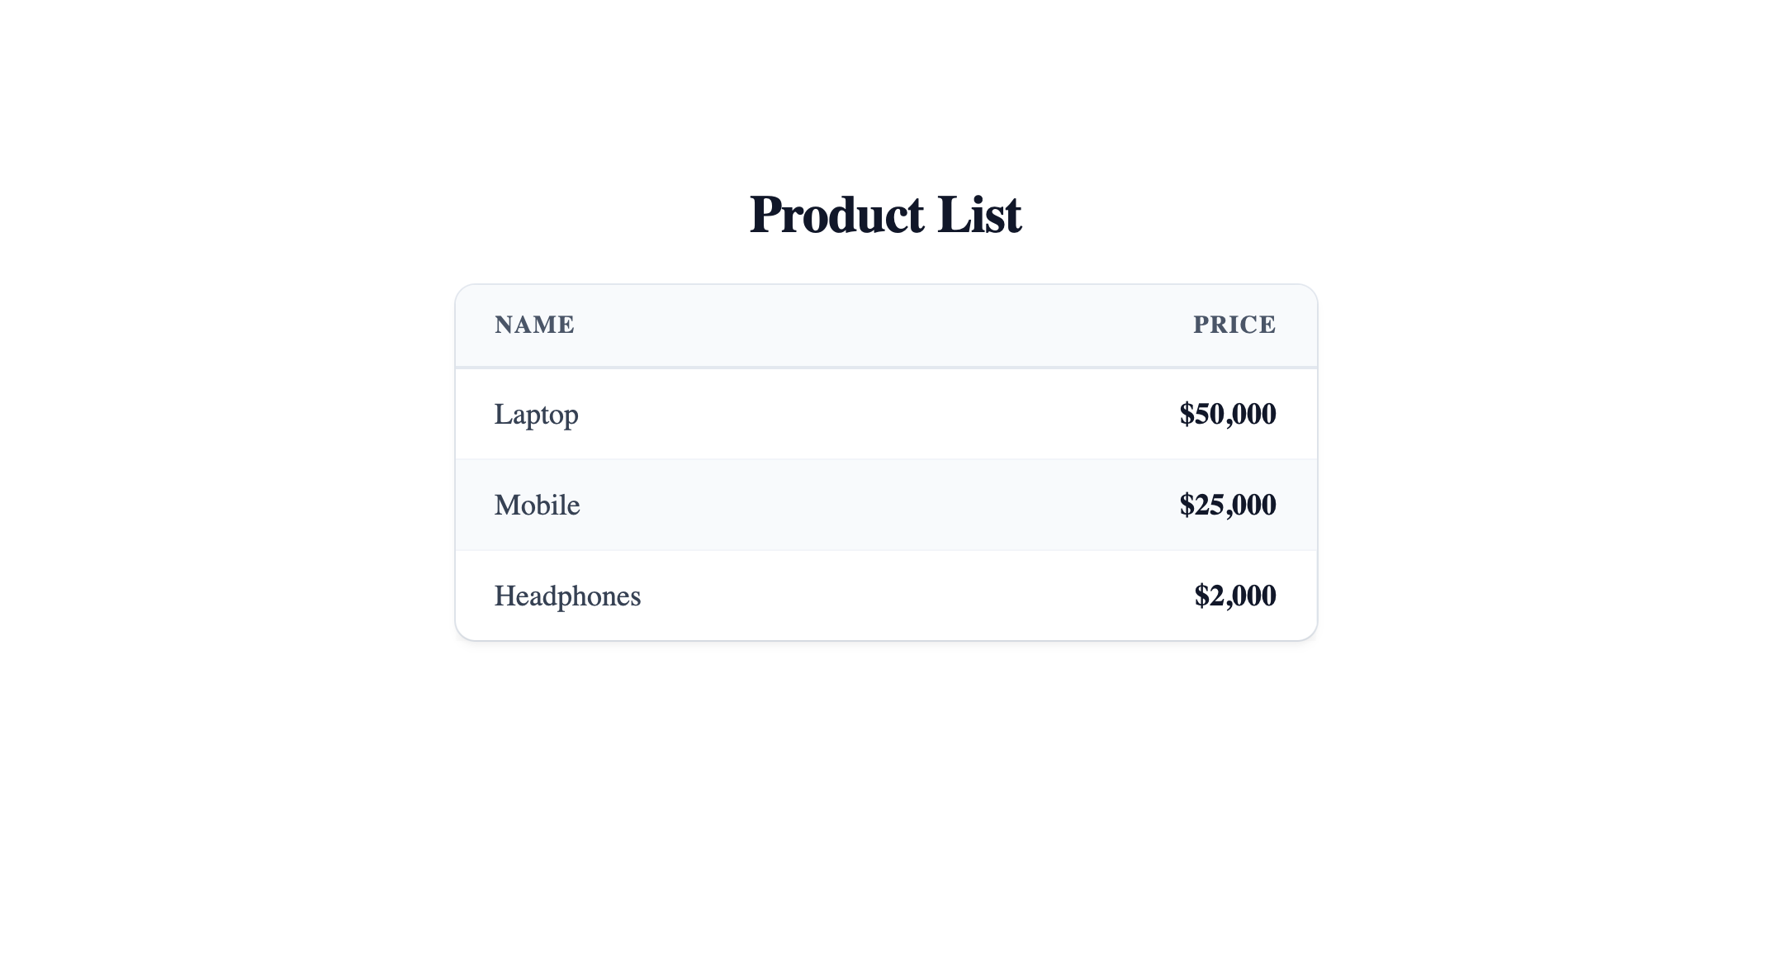
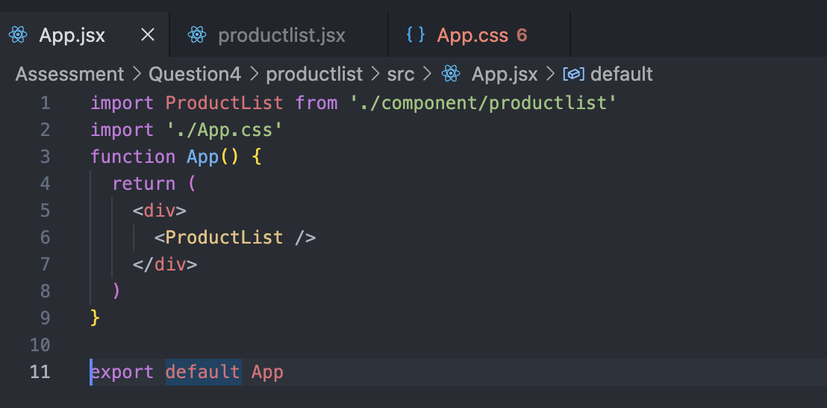
Question 4
Objective Display a list of products using React.
Requirements Create an array:
const products = [ { id: 1, name: "Laptop", price: 50000 }, { id: 2, name: "Mobile", price: 25000 }, { id: 3, name: "Headphones", price: 2000 } ];
Write a react component to display the output on the browser
should be as follows
Laptop $50000 Mobile $25000 Headphones $2000

